Slide 1
Cyclone Pattern Recognition & Classification
OJT Project
Track – Data Analytics
Team No. - 15

Slide 2
The Team
IBM Mentor
Ms. Tarannum Landge
Edunet Mentor
Mr. Alok Negi
Student Team
N Sunik
Dibyesh Mishra
Pradip Giri
Pranay Das

Slide 3
Contribution of each team member
Dibyesh – Data Collection, EDA, Model Training, Documentation.
N Sunik – ML/DL Model Training, Testing, Deployment, Documentation.
Pradip Giri – Data Collection, Dashboard creation, Deployment.
Pranay Das – Data collection, Documentation.

Slide 4
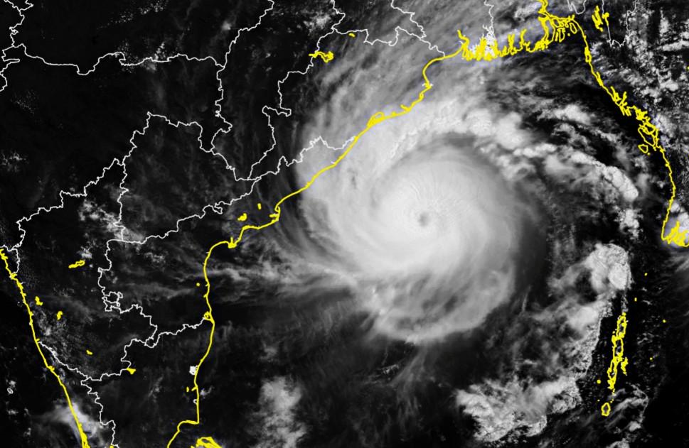
The Background
A tropical cyclone (TC) is a multihazard weather phenomenon,
India is one of the most vulnerable country to tropical cyclones .
Every year on average, 2–3 tropical cyclones make landfall in India.
Most of these tropical cyclones impact the east coast of Indian states of West Bengal, Odisha, Andhra Pradesh, Tamil Nadu.
http://www.cycloneoi.com/medias/images/cyclone-amphan-inde.jpg
Notes:
as it leads to heavy rainfall, gale wind and storm surge during the landfall.
2021 during the the second wave of coronavirus, people of our country have witnessed five cyclonic storms.
Cyclone Tauktae, Yaas,
Gulaab & Shaheen
Jawad and Several depression

Slide 5
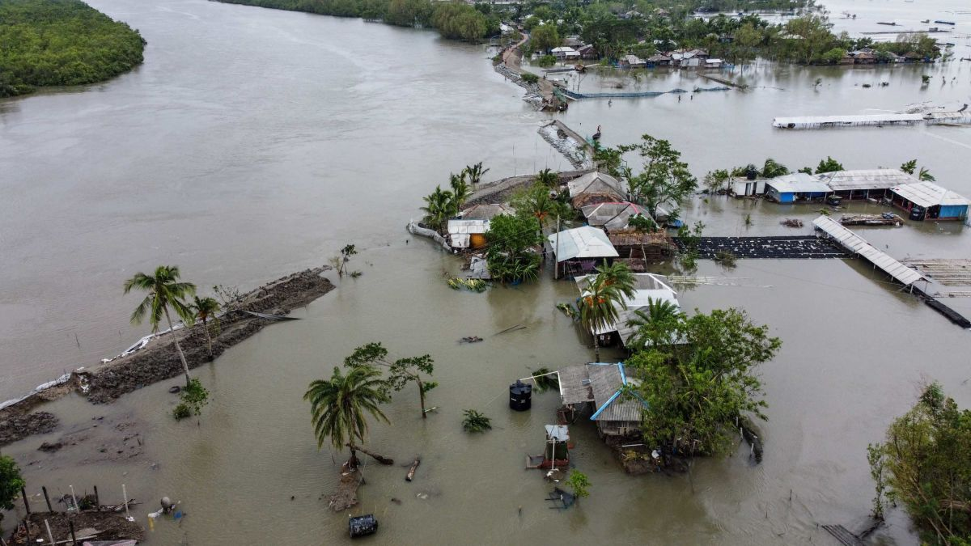
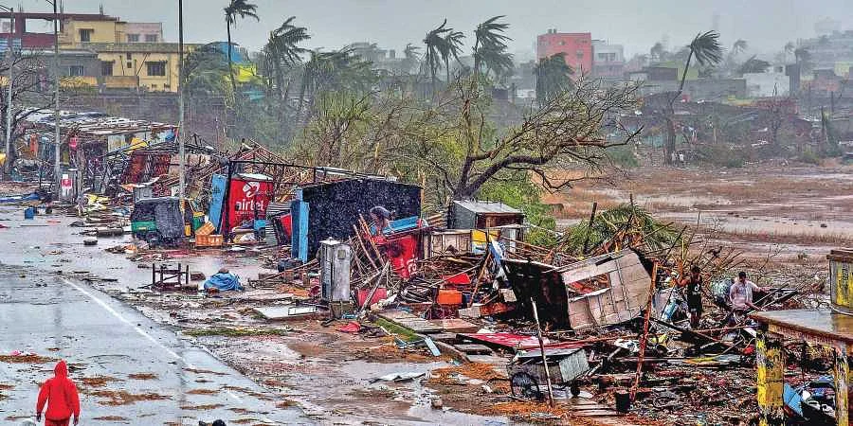
Problem Statement
The extreme weather events such as cyclones, storm surges etc. greatly influence the socio-economic status of India.
During this extreme events people lose lives and livelihood.
Accurate and early classifications required so that coastal population can be warned accordingly.
https://dynaimage.cdn.cnn.com/cnn/c_fill,g_auto,w_1200,h_675,ar_16:9/https%3A%2F%2Fcdn.cnn.com%2Fcnnnext%2Fdam%2Fassets%2F200521114531-07-cyclone-amphan-0521-shyamnagar.jpg
https://images.newindianexpress.com/uploads/user/imagelibrary/2019/5/11/w900X450/FANIS-RAGE.jpg
Notes:
Heavy rainfall, floods etc. are increasing due to the effect of climate change globally.

Slide 6
The aim of our project is to develop cyclone image classification model so the early classification and prediction will help understand the severity of the cyclone so that:
people can be warned
loss of lives and livelihood would be less,
organization can prepared well ahead to tackle the situation,
studies and research can speed up
new alert system can be effective

Slide 7
Proposed Solution
The use of advanced reading / learning (ML / DL) technology in meteorology has greatly improved in recent years.
By using CNN on satellite images of TCs and some climate data, we have tried to:
Classify and categorize according to early images.
Using historical data to train model.
This in turn will help authorities be prepared beforehand
Notes:
Prediction, classification and hence early warnings are issued.
Large amounts of weather data - improve training result and performance of the ML / DL model.
3. Face the TC accordingly
Warn during early stages
Minimize loss of man-made structures and the environment

Slide 8




Technology Stack & Requirements
Tech Stack:
Front-end:
Streamlit
Back-end:
Python(Numpy, Pandas, Keras, TensorFlow)
Hardware – Working PC, Internet
Software - Jupyter Notebook, VS Code, Microsoft Office, Kaggle, EOSDIS Worldview, Zoom Earth.
The app can be run on Windows, Mac, Linux. It has been hosted locally using Apache Tomcat.

Slide 9
Solution Design
Stage 1 -
Identify Problem
Stage 2 –
Gather Data
Stage 3 –
Data Pre-processing
Stage 4 –
Modelling
Stage 5 –
Evaluation/
Testing
Stage 6 –
Deployment
Zoom earth
Created own Dataset in Excel
Created Image dataset
Cyclone Patterns & Classification
Testing
Train Data & new data
Deployment
Streamlit
ImageDataGenerator
Data Augmentation
CNN-
Sequential

Slide 10
After identifying the problem, we gathered data using:
Zoom Earth (zoom.earth)
EOSDIS WorldView (worldview.earthdata.nasa.gov)
Then comes Data Pre-processing:
Image Augmentation
Used when less data is available.
Expand the size of your dataset.
New transformed images from original dataset - like shifting, rotating, flipping, zooming etc.
We used Keras ImageDataGenerator library to augment our image data
Keras ImageDataGenerator lets augment the images in real-time.

Slide 11
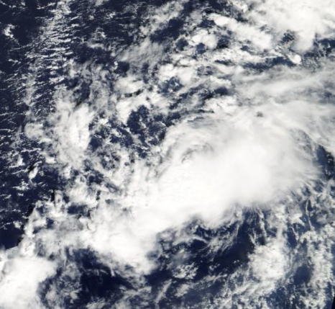
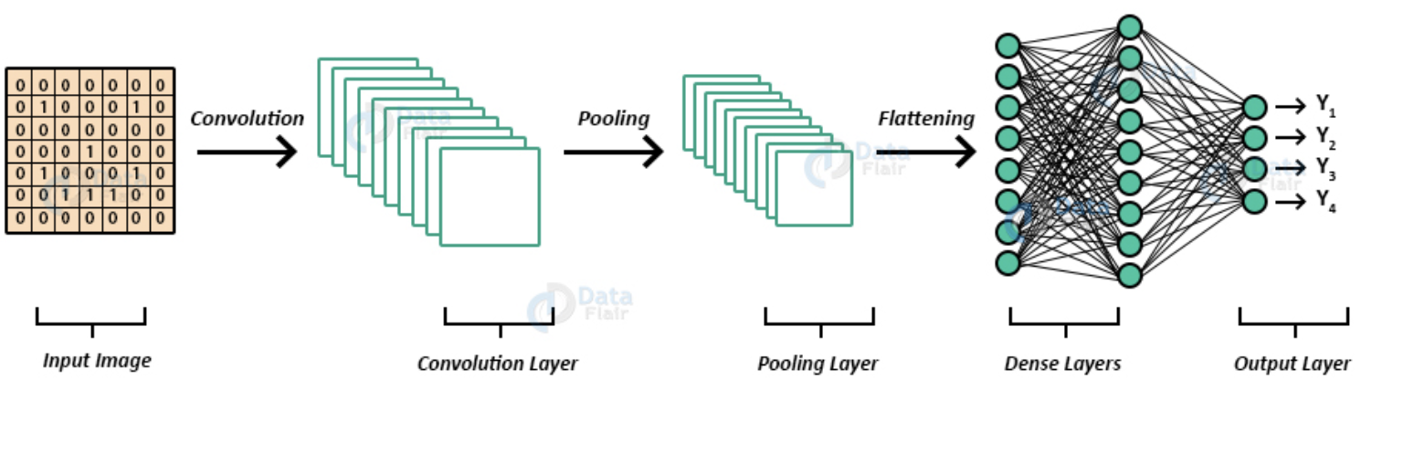
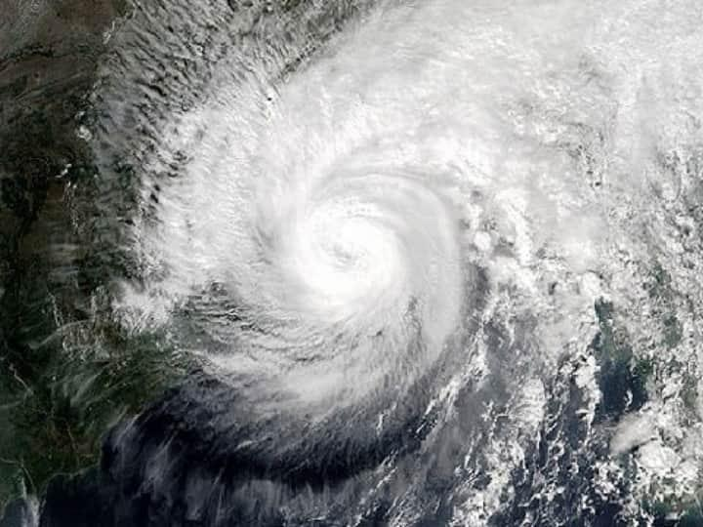
Convolutional Neural Network
CNN is a Supervised type of Deep learning, used in image recognition, detection and computer vision.
CNN has multiple layers that process and extract important features from the image.
Convolution Layer(Convolution Operation)
Pooling
Flattening
Fully Connected Layer
CNN Architecture

Slide 12
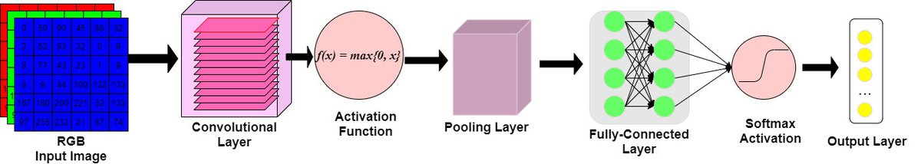
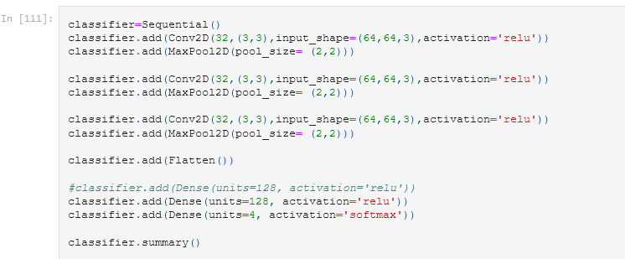
Filters/Kernel
Stride
Padding
Feature Maps
Activation Layers

Slide 13
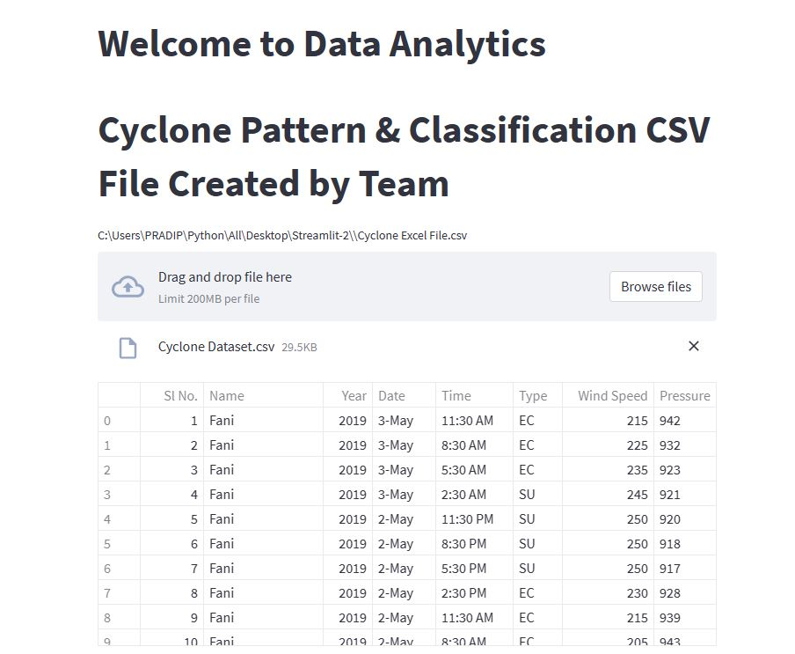
Innovative Idea
The project idea is novel idea - Cyclone Image Classification using Convolutional Neural Network.
Created our own Image Dataset.
Created our own model.
Can be used in alert system.
Enhance further studies and research.

Slide 14
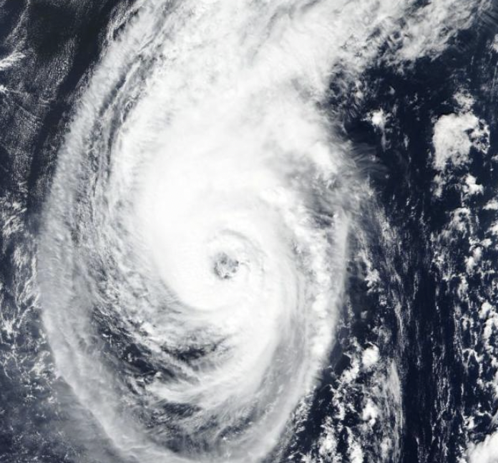
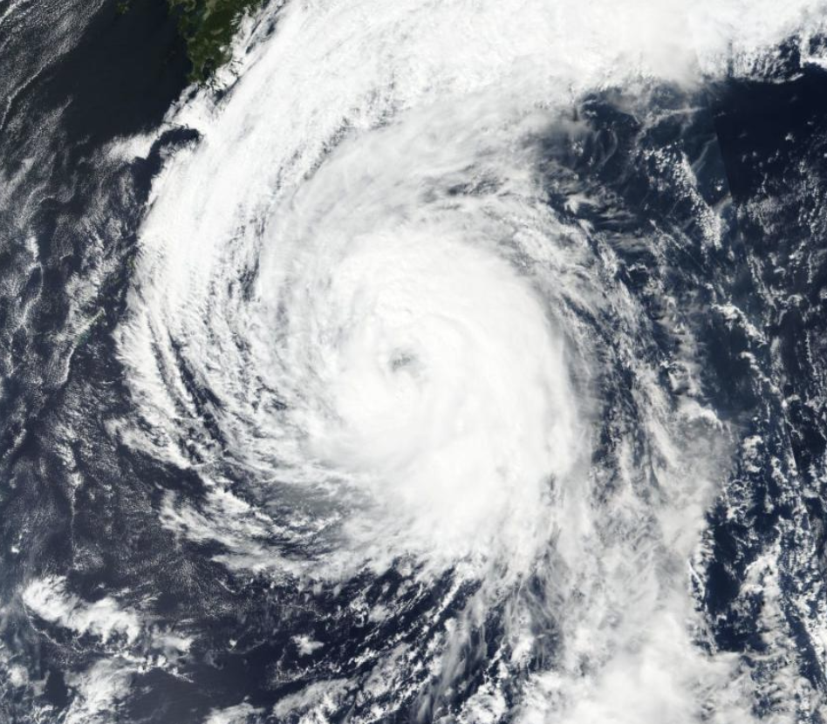
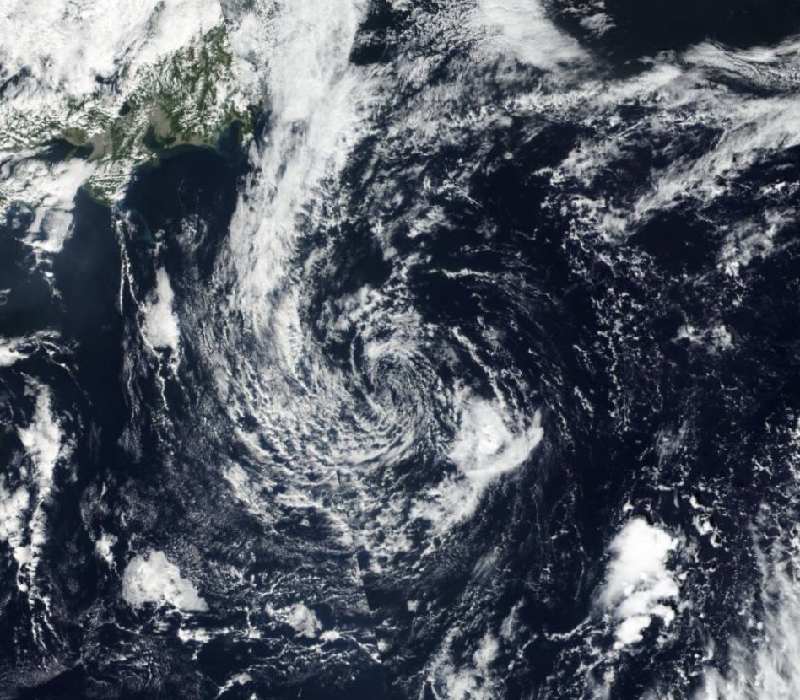
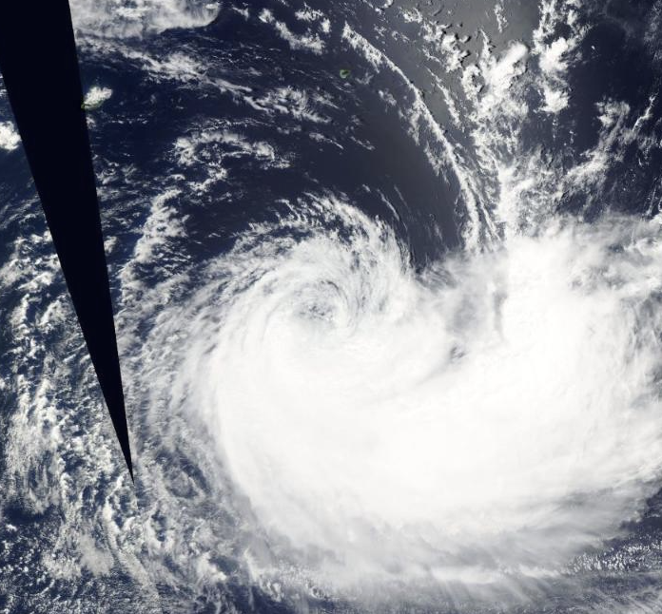
Image Dataset
Typhoon
Severe Tropical Storm
Tropical Depression
Tropical Storm

Slide 15
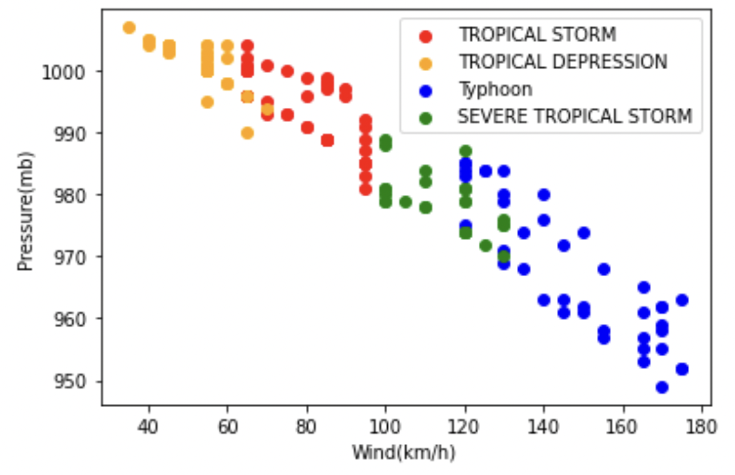
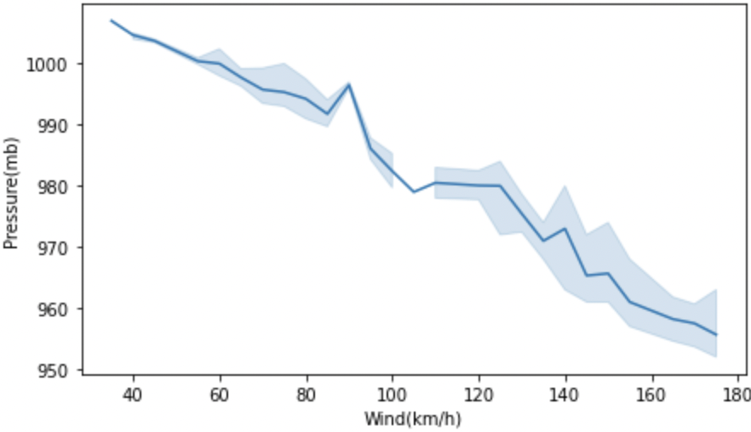
Results/Outcomes/Analysis
Analysis of cyclone data set
Classification of Tropical Cyclone using csv/excel
Wind vs Pressure

Slide 16
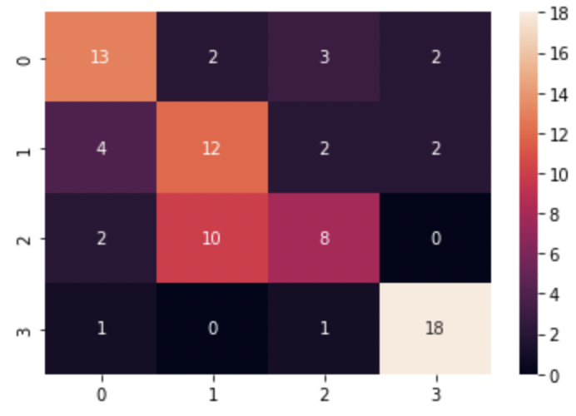
Analysis of Cyclone Image Dataset
If we give an image input, model can classify the class/Type
We used confusion matrix to evaluate the classifier.
The diagonal elements represent the number of
points for which the predicted label is equal to the
true label, while off-diagonal elements are those
that are mislabeled by the classifier

Slide 17
Limitations
Limited data -
most historical weather data and satellite images are not open source.
Proper and exact dataset -
images collected were not high resolution.
Domain knowledge -
have never worked on ML/DL projects hence, relatively newer subject.
CNN was our introduction model.

Slide 18
Future Enhancements/Scope
Train the model with lots of quality images for better output
Can use newer models and improve the accuracy and implement the model
Can be used as initial Emergency Alert system
Add features that would help coastal population estimate loss after a TC has hit.
Use of blockchain technology
Project iterations is needed to improve the accuracy

Slide 19
Streamlit App - https://share.streamlit.io/nsunik/cyclone_image_classification/main/app.py Jupyter NoteBook- https://github.com/nsunik/cyclone_classification/blob/main/Cyclone_Image_classification_cnn-2.ipynb
Demo Links

Slide 20
Thank You

